Slide 1
COMP 4500
Week 15 - Friday

Slide 2
Last time
What did we talk about last time?
Review of first third of course
  Big oh
  Calculating running time
  Graph basics
  Greedy algorithms
    Interval scheduling
    Shortest path
    Minimum spanning tree
    Huffman codes

Slide 3
Questions?

Slide 4
Assignment 7

Slide 5
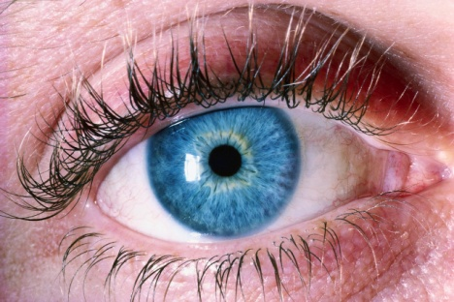
Logical warmup
People with assorted eye colors live on an island. They are all perfect logicians: If a conclusion can be logically deduced, they will do it instantly. No one knows their own eye color. Every night at midnight, a ferry stops at the island. Any islanders who have figured out the color of their own eyes must leave the island, and the rest stay. Everyone can see everyone else at all times and keeps a count of the number of people they see with each eye color (excluding themselves), but they cannot otherwise communicate. Everyone on the island knows these rules.
On this island there are 100 blue-eyed people, 100 brown-eyed people, and the Guru (she happens to have green eyes). So any given blue-eyed person can see 100 people with brown eyes and 99 people with blue eyes (and one with green), but that does not tell him his own eye color; as far as he knows the totals could be 101 brown and 99 blue. Or 100 brown, 99 blue, and he could have red eyes.
The Guru is allowed to speak once, at noon, on one day in all their endless years on the island. Standing before the islanders, she says the following:
"I can see someone who has blue eyes."
Who leaves the island, and on what night?

Slide 6
Review

Slide 7
Final exam
Final exam:
  Friday, April 24, 2026
  10:15 a.m. – 12:15 p.m.
It will mostly be short answer
There will be diagrams
There might be a matching problem
There will likely be a (simple) proof
It will be 50% longer than previous exams, but you will have 100% more time

Slide 8
Recurrence Relations

Slide 9
Divide and conquer
Divide and conquer algorithms are ones in which we divide a problem into parts and recursively solve each part
Then, we do some work to combine the solutions to each part into a final solution
Divide and conquer algorithms are often simple
However, their running time can be challenging to compute because recursion is involved

Slide 10
Mergesort algorithm
If there are two elements in the array or fewer then
  Make sure they're in order
Else
  Divide list into two halves
  Recursively merge sort the two halves
  Merge the two sorted halves together into the final list

Slide 11
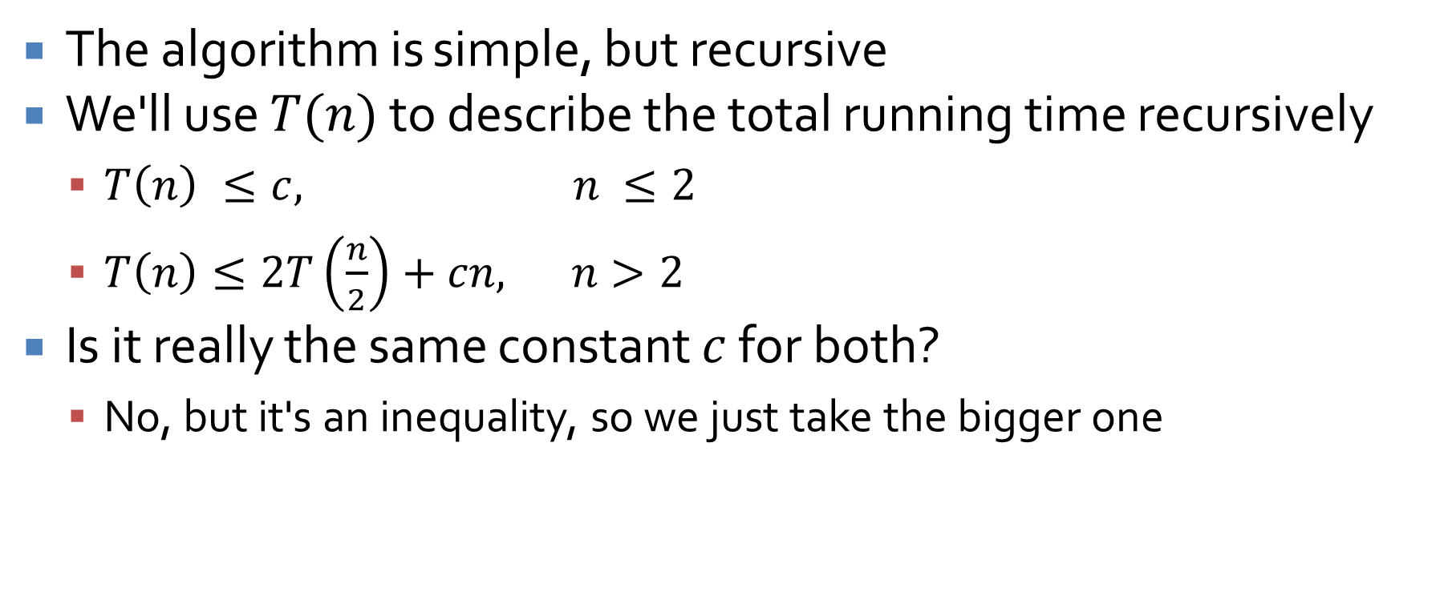
Time for mergesort
The algorithm is simple, but recursive
We'll use $T(n)$ to describe the total running time recursively
  $T\left(n\right) ≤c, n ≤2$
  $T\left(n\right)≤2T\left(\frac{n}{2}\right)+cn, n>2$
Is it really the same constant $c$ for both?
  No, but it's an inequality, so we just take the bigger one

Slide 12
Intuition about mergesort recursion
Each time, the recursion cuts the work in half while doubling the number of problems
  The total work at each level is thus always $cn$
To go from $n$ to $2$, we have to cut the size in half $(\log_{2} n) – 1$ times
$$cn$$
$$cn$$
$$cn$$
$$cn$$
$$\frac{cn}{2}$$
$$\frac{cn}{2}$$
$$\frac{cn}{4}$$
$$\frac{cn}{4}$$
$$\frac{cn}{4}$$
$$\frac{cn}{4}$$

Slide 13
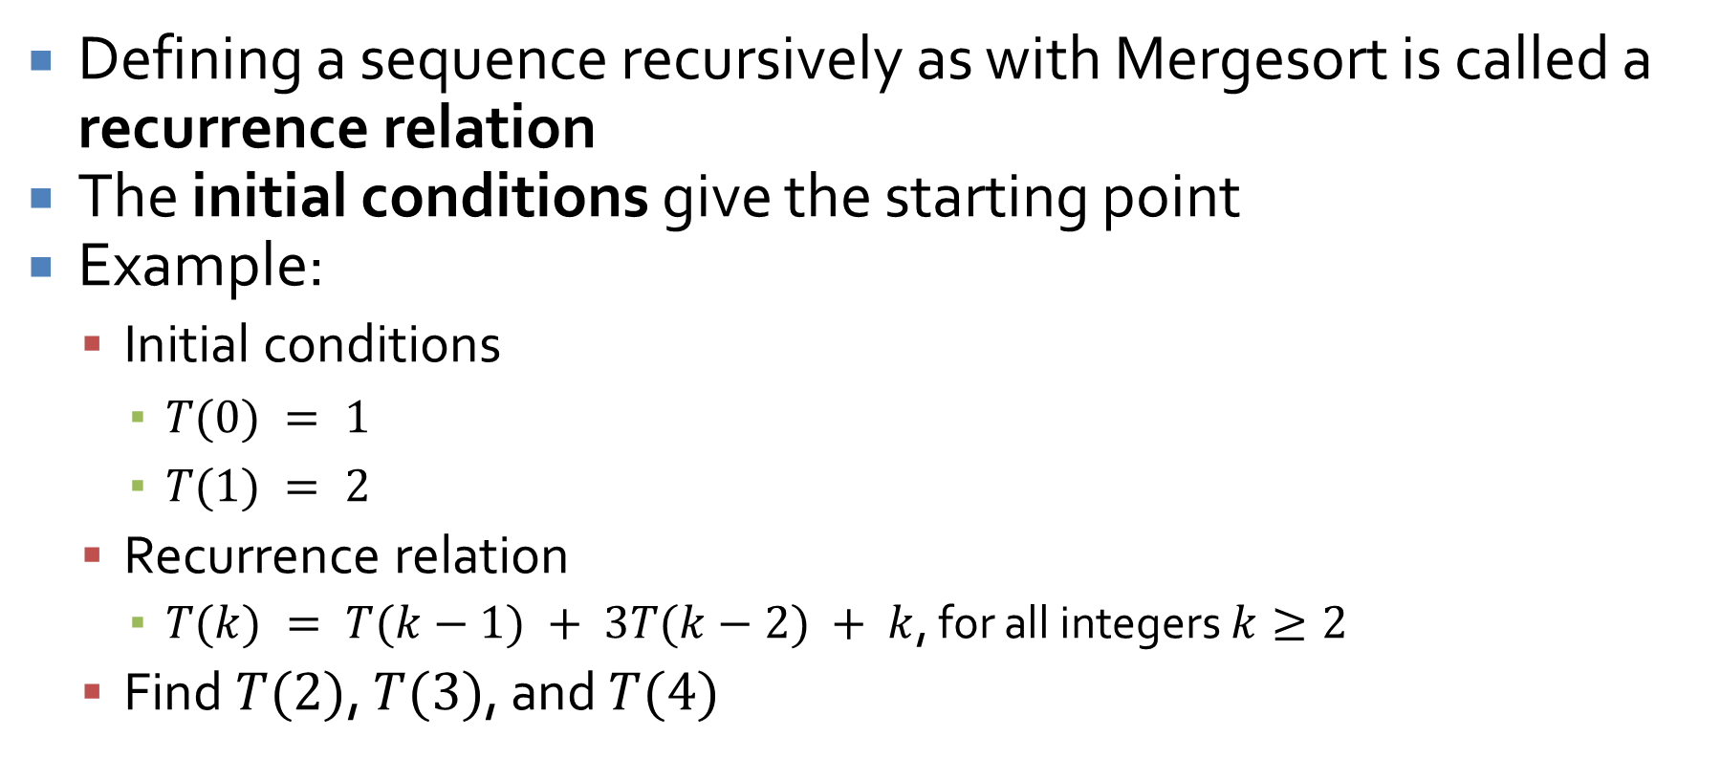
Recursively defined sequences
Defining a sequence recursively as with Mergesort is called a recurrence relation
The initial conditions give the starting point
Example:
  Initial conditions
    $T(0) = 1$
    $T(1) = 2$
  Recurrence relation
    $T(k) = T(k−1) + 3T(k−2) + k$, for all integers $k≥2$
  Find $T(2)$, $T(3)$, and $T(4)$

Slide 14
Finding explicit formulas by iteration
We want to be able to turn recurrence relations into explicit formulas whenever possible
Often, the simplest way is to find these formulas by iteration
The technique of iteration relies on writing out many expansions of the recursive sequence and looking for patterns
That's it

Slide 15
Employing outside formulas
Intelligent pattern matching gets you a long way
However, it is sometimes necessary to substitute in some known formula to simplify a series of terms
Recall
  Geometric series: $1 + r + r^{2} + … + r^{n} =\frac{r^{n+1} – 1}{r – 1}$
  Arithmetic series: $1 + 2 + 3 + … + n =\frac{n\left(n + 1\right)}{2}$

Slide 16
Further recurrence relations
We have seen that recurrence relations of the form $T\left(n\right)≤2T\left(\frac{n}{2}\right)+cn$ are bounded by $O(n log⁡n)$
What about $T\left(n\right)≤qT\left(\frac{n}{2}\right)+cn$ where $q$ is bigger than 2 (more than two sub-problems)?
There will still be $\log_{2}{n}$ levels of recursion
However, there will not be a consistent $cn$ amount of work at each level

Slide 17
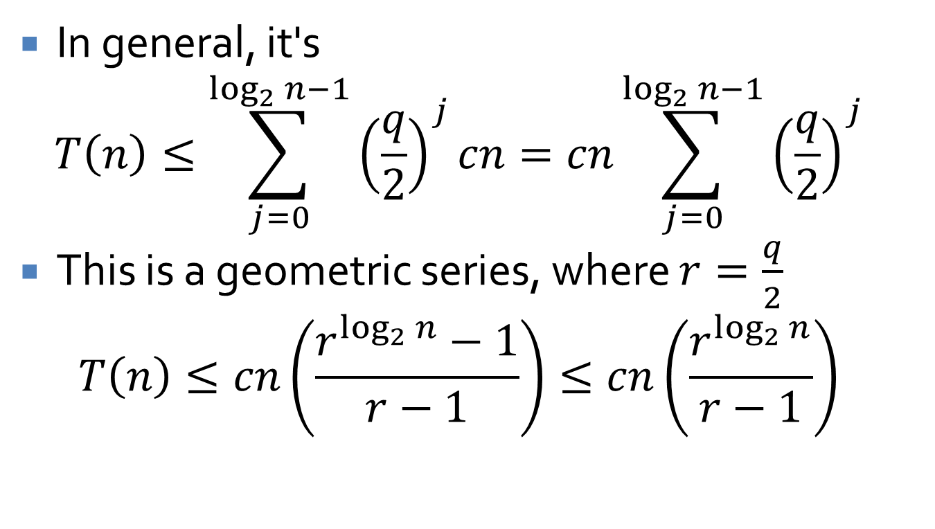
Converting to summation
In general, it's
$$T\left(n\right)≤\sum_{j=0}^{\log_{2}{n−1}}{{\left(\frac{q}{2}\right)}^{j}cn}=cn\sum_{j=0}^{\log_{2}{n−1}}{{\left(\frac{q}{2}\right)}^{j}}$$
This is a geometric series, where $r=\frac{q}{2}$
$$T\left(n\right)≤cn\left(\frac{r^{\log_{2}{n}}−1}{r−1}\right)≤cn\left(\frac{r^{\log_{2}{n}}}{r−1}\right)$$

Slide 18
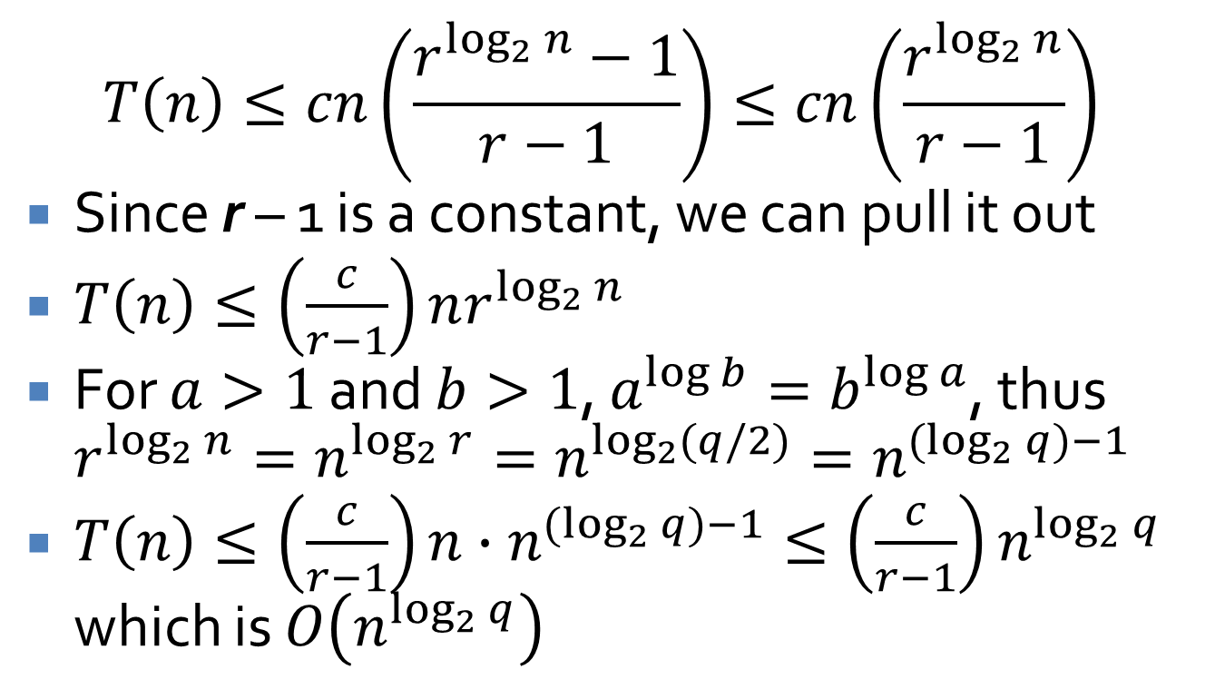
Final bound
$$T\left(n\right)≤cn\left(\frac{r^{\log_{2}{n}}−1}{r−1}\right)≤cn\left(\frac{r^{\log_{2}{n}}}{r−1}\right)$$
Since r – 1 is a constant, we can pull it out
$T\left(n\right)≤\left(\frac{c}{r−1}\right)nr^{\log_{2}{n}}$
For $a>1$ and $b>1$, $a^{\log{b}}=b^{\log{a}}$, thus $r^{\log_{2}{n}}=n^{\log_{2}{r}}=n^{\log_{2}{(q/2)}}=n^{(\log_{2}{q})−1}$
$T\left(n\right)≤\left(\frac{c}{r−1}\right)n∙n^{(\log_{2}{q})−1}≤\left(\frac{c}{r−1}\right)n^{\log_{2}{q}}$ which is $O\left(n^{\log_{2}{q}}\right)$

Slide 19
Counting Inversions

Slide 20
Ranking similarity
What if we wanted to measure the similarity of one ranking to another ranking?
Inversions are pairs of elements that are out of order in one ranking with respect to the other
Formally, for indices $i < j$, there's an inversion if ranking $r_{i} > r_{j}$

Slide 21
Minimum and maximum inversions
If two rankings are the same, they would have no inversions
If two rankings were sorted in opposite directions, they would have $\left(\begin{matrix}n \\ 2\end{matrix}\right)=\frac{n!}{\left(n−2\right)!2!}=\frac{n(n−1)}{2}$ inversions

Slide 22
Visualization of inversions
You can visualize inversions as the number of line segments crossings if you match up items in one list with the other
A total of 4 inversions
Sinners
Hamnet
Marty Supreme
One Battle After Another
Hamnet
One Battle After Another
Marty Supreme
Sinners

Slide 23
Can we do better than $O(n^{2})$?
Of course!
We can borrow from the Mergesort algorithm
Divide the problem in half
Then, we will get the number of inversions in the first half and in the second half
Are we done?
  No, we also have to count the inversions between the first half and the second half
  Those are exactly those elements in the first half that are bigger than elements from the second half
  We can find those during the merge process

Slide 24
Merge-and-Count($A$, $B$)
Maintain a $Current$ pointer into each list, initialized to point to the front elements
Set $Count = 0$
While both lists have elements
  Let $a_{i}$ and $b_{j}$ be the elements pointed to by the $Current$ pointer
  Append the smaller one to the output list
  If $b_{j}$ is smaller then
    Increment $Count$ by the number of elements left in $A$
  Advance the $Current$ pointer in the list that had the smaller element

Slide 25
Sort-and-Count($L$)
If the list has one element then
  Return $0$ inversions and the list $L$
Else
  Divide the list into two halves:
    $A$ has the first $\left\lceil \frac{n}{2}\right\rceil$ elements
    $B$ has the remaining $\left\lfloor \frac{n}{2}\right\rfloor$ elements
  $(inversions_{A}, A)$ = Sort-and-Count($A$)
  $(inversions_{B}, B)$ = Sort-and-Count($B$)
  $(inversions, L)$ = Merge-and-Count($A$, $B$)
  Return $inversions + inversions_{A} + inversions_{B}$ and sorted list $L$

Slide 26
Running time
Since Merge-and-Count is bounded by $O(n)$, the running time for Sort-and-Count is clearly:
  $T(1)≤c$
  $T\left(n\right)≤2T\left(\frac{n}{2}\right)+cn$, for $n≥2$
By the same analysis as for Mergesort, $T(n)$ is $O(n log⁡n)$

Slide 27
Closest Pair of Points

Slide 28
Closest pair of points
Imagine you have a set of points in a 2D plane
How do you find the pair of points that's closest?
This is a fundamental problem in the area of computational geometry
As usual, you could look at all pairs of points

Slide 29
Designing the algorithm
To make things simpler, we assume that no two points have the same $x$-coordinate or $y$-coordinate
Think about a one-dimensional approach:
  Sort the list by $x$-value
  The two closest points must be next to each other in the list

Slide 30
Divide
Since the name of the chapter is divide and conquer, that's what we do
First, sort all of the points by increasing $x$-values, calling this list $P_{x}$
Then, sort all of the points by increasing $y$-values, calling this list $P_{y}$
Find the median point in $P_{x}$ and drop a line through it, dividing the points into those with smaller $x$ (set $Q$) and larger $x$ (set $R$)
Recursively find the closest pair of points on the left side and the closest pair of points on the right side

Slide 31
Divide points
$$Q$$
$$L$$
$$R$$

Slide 32
… and …
We have magically recursively found the closest pair of points in $Q$ and the closest pair in $R$
  Between those two pairs, let's say the closest has distance $δ$
But what if the closest pair straddles $L$, with one point in Q and the other in $R$?
We do a linear scan of $P_{y}$, the list of points sorted by $y$ values, making a new $y$-sorted list of points $S_{y}$ whose $x$-coordinate is within $δ$ of $L$

Slide 33
… conquer!
We scan through the list $S_{y}$
For each element, we compute the distance between it and the next $15$ elements
We find the closest distance
If the closest distance is smaller than $δ$, that's the true closest pair
Otherwise, we use the smaller of the pairs from $Q$ and $R$

Slide 34
Divide points
$δ$
$$Q$$
$$R$$
δ
$\frac{δ}{2}$
$\frac{δ}{2}$

Slide 35
Running time
Pre-processing:
  Sort the points by $x$: $O(n log⁡n)$
  Sort the points by $y$: $O(n log⁡n)$
Recursion:
  If there are three or fewer points, find the closest pair by comparing all pairs
  Otherwise, divide into sets $Q$ and $R$: $O(n)$ time
  Make lists $Q_{x}$, $Q_{y}$, $R_{x}$, and $R_{y}$, giving the points in $Q$ and $R$ sorted by $x$ and $y$, respectively: $O(n)$ time
  Construct $S_{y}$: $O(n)$ time
  For every point in $S_{y}$ (of which there can only be $n$), compute the distance to the next $15$ points: $O(n)$
$T\left(n\right)≤2T\left(\frac{n}{2}\right)+cn$ which is $O(n\log{n)}$

Slide 36
Integer Multiplication

Slide 37
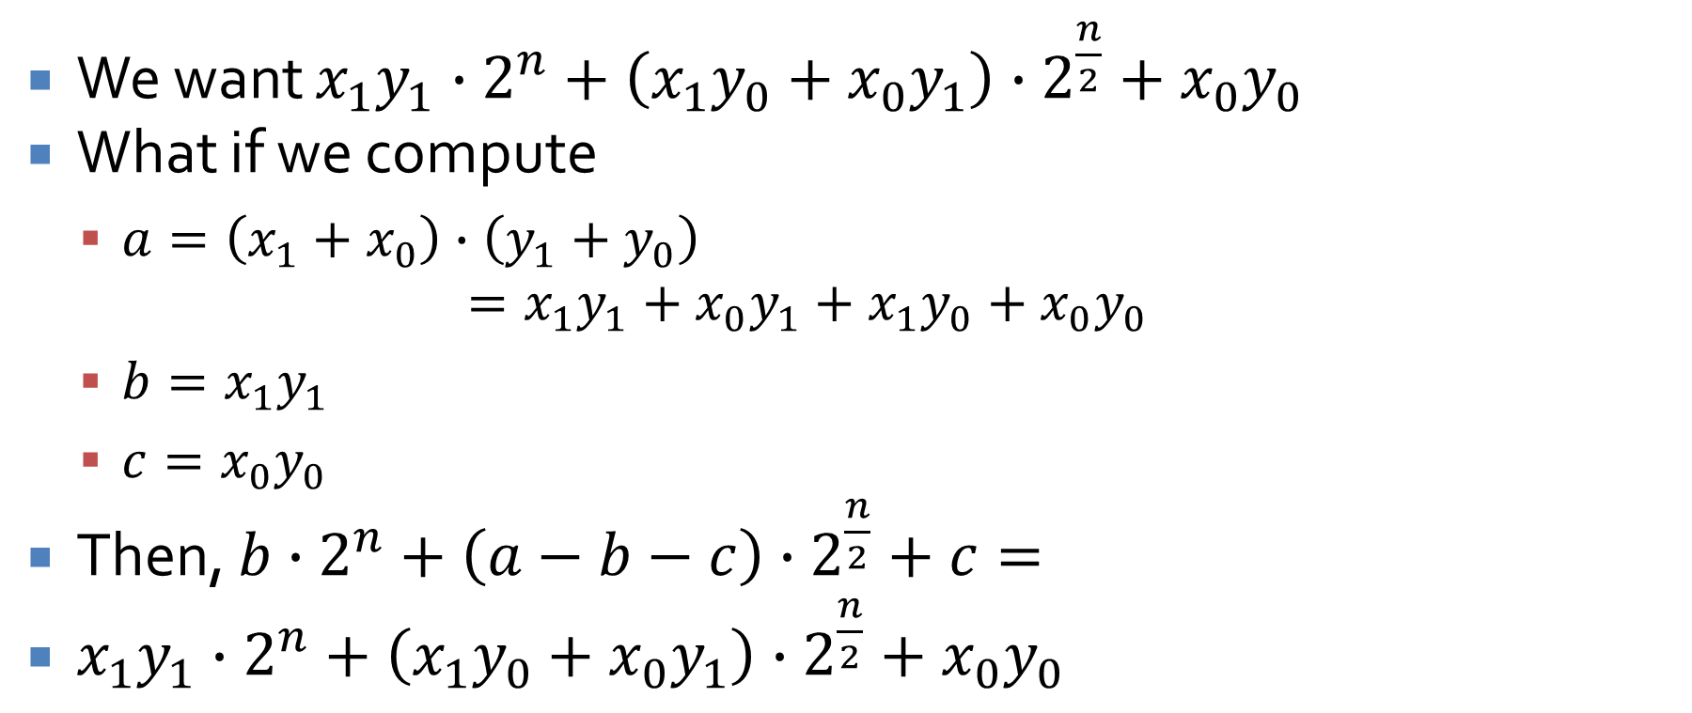
We need a trick
We want $x_{1}y_{1}∙2^{n}+\left({x_{1}y}_{0}+{x_{0}y}_{1}\right)∙2^{\frac{n}{2}}+{x_{0}y}_{0}$
What if we compute
  $a=\left(x_{1}+x_{0}\right)∙\left(y_{1}+y_{0}\right)$
  $$=x_{1}y_{1}+x_{0}y_{1}+x_{1}y_{0}+x_{0}y_{0}$$
  $b=x_{1}y_{1}$
  $c=x_{0}y_{0}$
Then, $b∙2^{n}+\left(a−b−c\right)∙2^{\frac{n}{2}}+c=$
$x_{1}y_{1}∙2^{n}+\left({x_{1}y}_{0}+{x_{0}y}_{1}\right)∙2^{\frac{n}{2}}+{x_{0}y}_{0}$

Slide 38
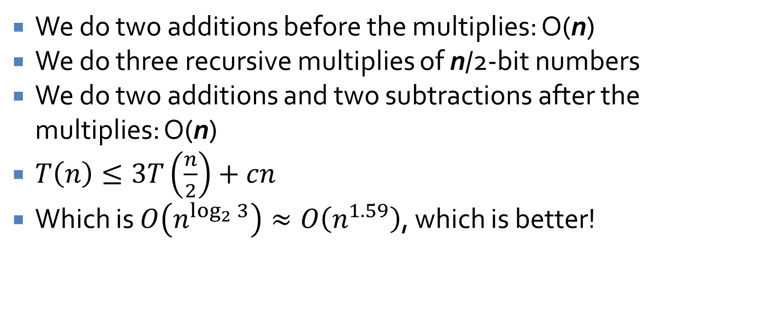
Running time
We do two additions before the multiplies: O(n)
We do three recursive multiplies of n/2-bit numbers
We do two additions and two subtractions after the multiplies: O(n)
$T\left(n\right)≤3T\left(\frac{n}{2}\right)+cn$
Which is $O\left(n^{\log_{2}{3}}\right)≈O\left(n^{1.59}\right)$, which is better!

Slide 39
Master Theorem

Slide 40
Basic form of the Master Theorem
For recursion that on a problem size $n$ that:
  Makes $a$ recursive calls
  Divides the total work by $b$ for each recursive call
  Does $f(n)$ non-recursive work at each call
Its running time can be given in the following form, suitable for use in the Master Theorem:
$T\left(n\right)=aT\left(\frac{n}{b}\right)+f\left(n\right),$
where $a≥1 and b>1$

Slide 41
Case 1
If $f\left(n\right) is O\left(n^{\log_{b}{(a)}−ε}\right)$
for some constant $ε>0$, then
$$T\left(n\right) \text{is} Θ\left(n^{\log_{b}{(a)}}\right)$$

Slide 42
Case 2
If $f\left(n\right) is Θ\left(n^{\log_{b}{(a)}}\log^{k}{n}\right)$
for some constant $k≥0$, then
$$T\left(n\right) \text{is} Θ\left(n^{\log_{b}{(a)}}\log^{k+1}{n}\right)$$

Slide 43
Case 3
If $f\left(n\right) is Ω\left(n^{\log_{b}{(a)}+ε}\right)$
for some constant $ε>0$, and if
$$af\left(\frac{n}{b}\right)≤cf(n)$$
for some constant $c<1$ and sufficiently large $n$, then
$$T\left(n\right) \text{is} Θ\left(f(n)\right)$$

Slide 44
Example Problems

Slide 45
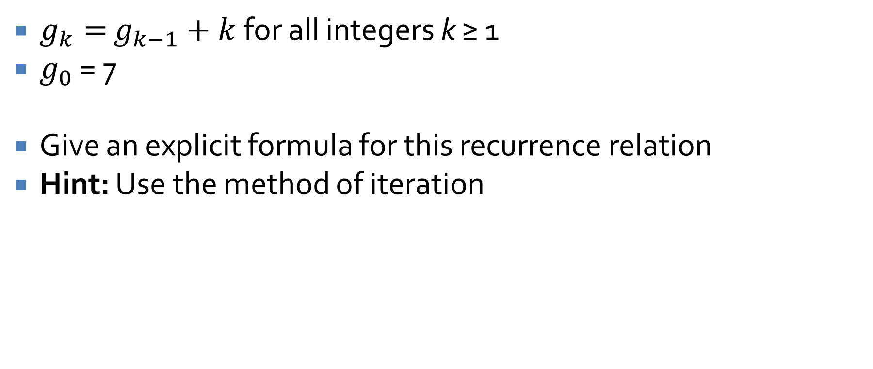
Recursive sequence example
$g_{k}=$ $g_{k−1}+k$ for all integers k ≥ 1
$g_{0}$ = 7
Give an explicit formula for this recurrence relation
Hint: Use the method of iteration

Slide 46
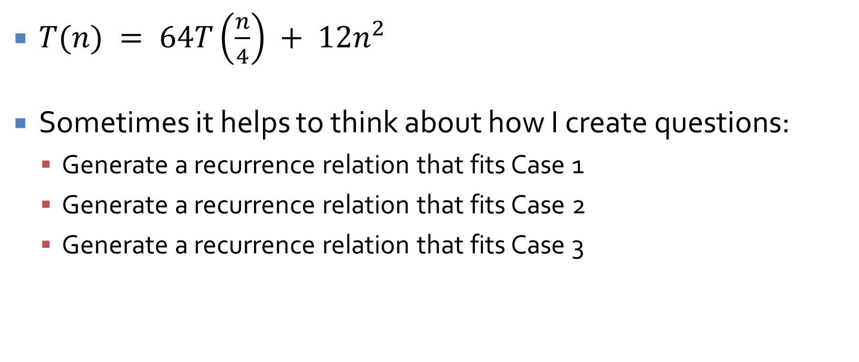
Sample master theorem problem
$T(n) = 64T\left(\frac{n}{4}\right) + 12n^{2}$
Sometimes it helps to think about how I create questions:
  Generate a recurrence relation that fits Case 1
  Generate a recurrence relation that fits Case 2
  Generate a recurrence relation that fits Case 3

Slide 47
Dynamic Programming

Slide 48
Weighted interval scheduling
The weighted interval scheduling problem extends interval scheduling by attaching a weight (usually a real number) to each request
Now the goal is not to maximize the number of requests served but the total weight
Our greedy approach is worthless, since some high value requests might be tossed out
We could try all possible subsets of requests, but there are exponential of those
Dynamic programming will allow us to save parts of optimal answers and combine them efficiently

Slide 49

Notation
We have $n$ requests labeled $1, 2,…, n$
Request $i$ has a start time $s_{i}$ and a finish time $f_{i}$
Request $i$ has a value $v_{i}$
Two intervals are compatible if they don't overlap

Slide 50
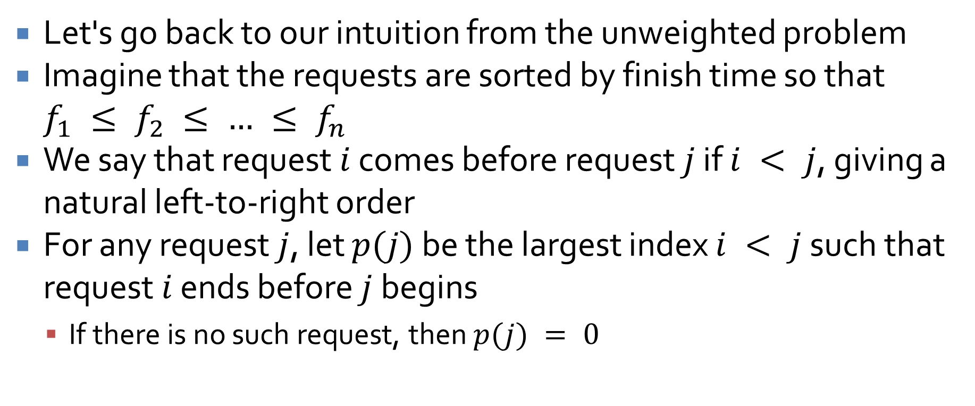
Designing the algorithm
Let's go back to our intuition from the unweighted problem
Imagine that the requests are sorted by finish time so that $f_{1} ≤ f_{2} ≤ … ≤ f_{n}$
We say that request $i$ comes before request $j$ if $i < j$, giving a natural left-to-right order
For any request $j$, let $p(j)$ be the largest index $i < j$ such that request $i$ ends before $j$ begins
  If there is no such request, then $p(j) = 0$

Slide 51

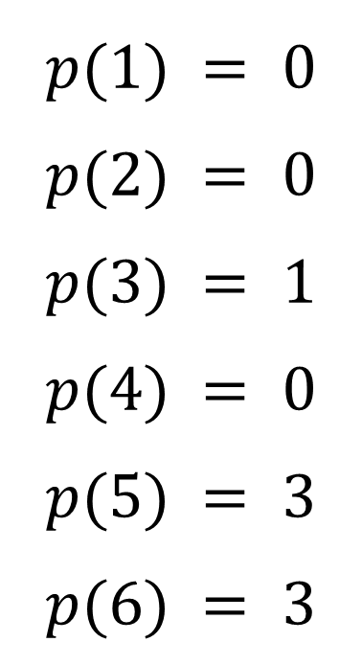

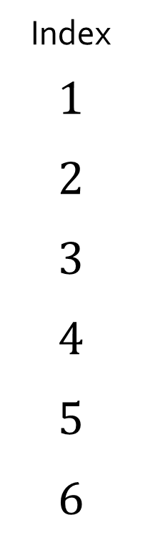




p(j) examples
Index
$$1$$
$$2$$
$$3$$
$$4$$
$$5$$
$$6$$
$$2$$
$$p(1) = 0$$
$$p(2) = 0$$
$$p(3) = 1$$
$$p(4) = 0$$
$$p(5) = 3$$
$$p(6) = 3$$
$$4$$
$$4$$
$$7$$
$$2$$
$$1$$

Slide 52

Iterative solution to find value of weighted interval scheduling
Iterative-Compute-Opt
  $M[0] = 0$
  For $j = 1$ up to $n$
    $M[j] = max⁡(v_{j} + M[p(j)], M[j – 1])$
Algorithm is O(n)

Slide 53
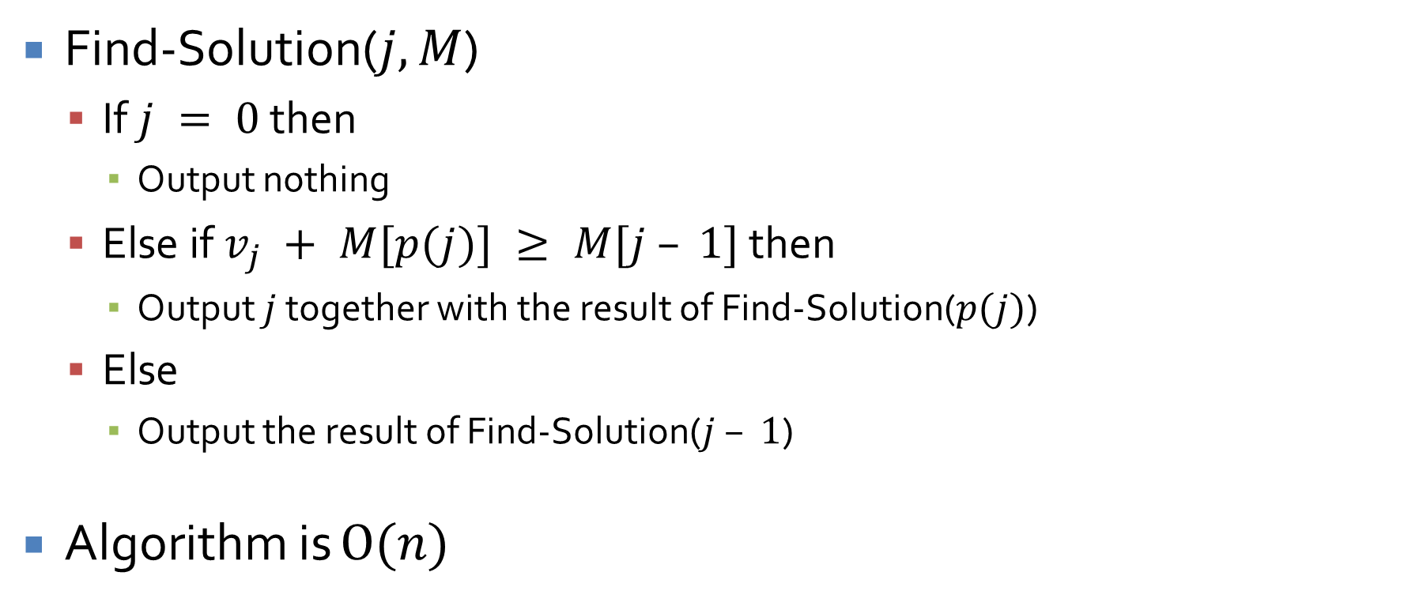
Algorithm for solution
Find-Solution($j, M$)
  If $j = 0$ then
    Output nothing
  Else if $v_{j} + M[p(j)] ≥ M[j – 1]$ then
    Output $j$ together with the result of Find-Solution($p(j)$)
  Else
    Output the result of Find-Solution($j – 1$)
Algorithm is $O(n)$

Slide 54
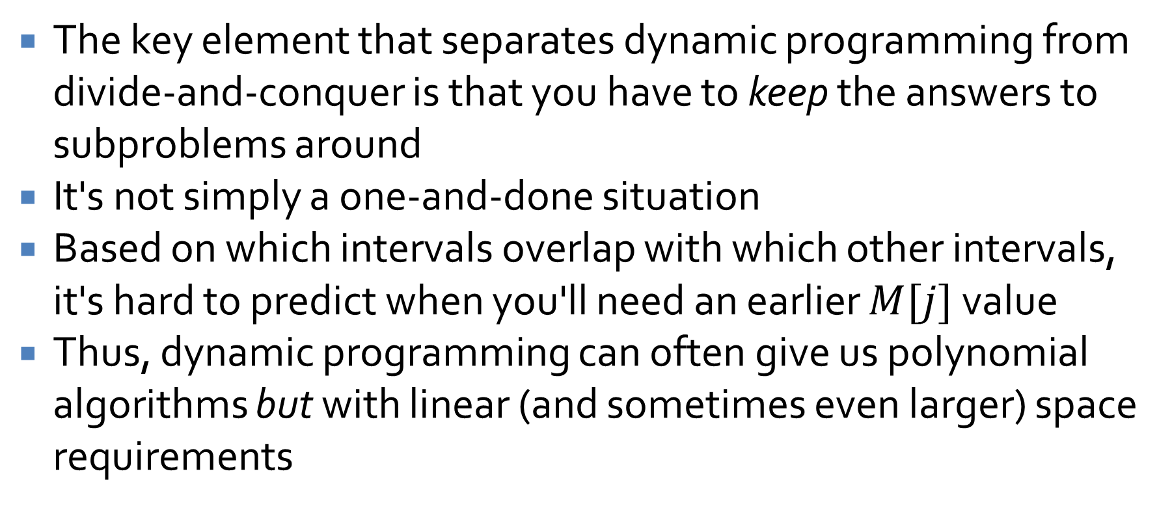
Why is this dynamic programming?
The key element that separates dynamic programming from divide-and-conquer is that you have to keep the answers to subproblems around
It's not simply a one-and-done situation
Based on which intervals overlap with which other intervals, it's hard to predict when you'll need an earlier $M[j]$ value
Thus, dynamic programming can often give us polynomial algorithms but with linear (and sometimes even larger) space requirements

Slide 55
Informal guidelines
Weighted interval scheduling follows a set of informal guidelines that are essentially universal in dynamic programming solutions:
  There are only a polynomial number of subproblems
  The solution to the original problem can easily be computed from (or is one of) the solutions to the subproblems
  There is a natural ordering of subproblems from "smallest" to "largest"
  There is an easy-to-compute recurrence that lets us compute the solution to a subproblem from the solutions of smaller subproblems

Slide 56
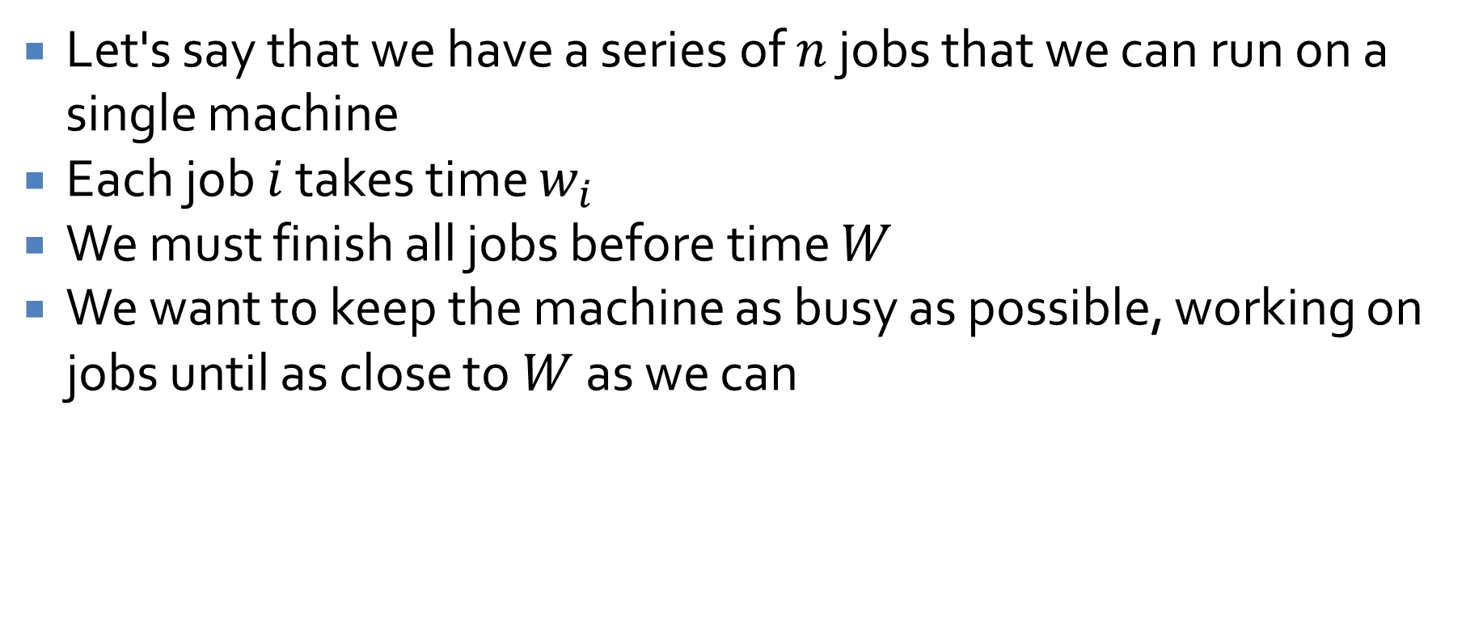
Subset sum
Let's say that we have a series of $n$ jobs that we can run on a single machine
Each job $i$ takes time $w_{i}$
We must finish all jobs before time $W$
We want to keep the machine as busy as possible, working on jobs until as close to $W$ as we can

Slide 57
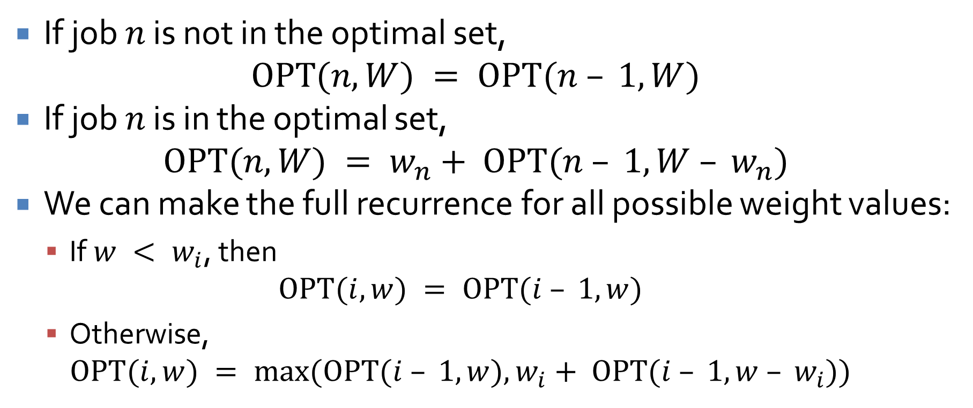
A new recurrence
If job $n$ is not in the optimal set,
$$OPT(n, W) = OPT(n – 1, W)$$
If job $n$ is in the optimal set,
$$OPT(n, W) = w_{n}+ OPT(n – 1, W – w_{n})$$
We can make the full recurrence for all possible weight values:
  If $w < w_{i}$, then
  $$OPT(i, w) = OPT(i – 1, w)$$
  Otherwise,
  $$OPT(i, w) = max⁡(OPT(i – 1, w), w_{i}+ OPT(i – 1, w – w_{i}))$$

Slide 58
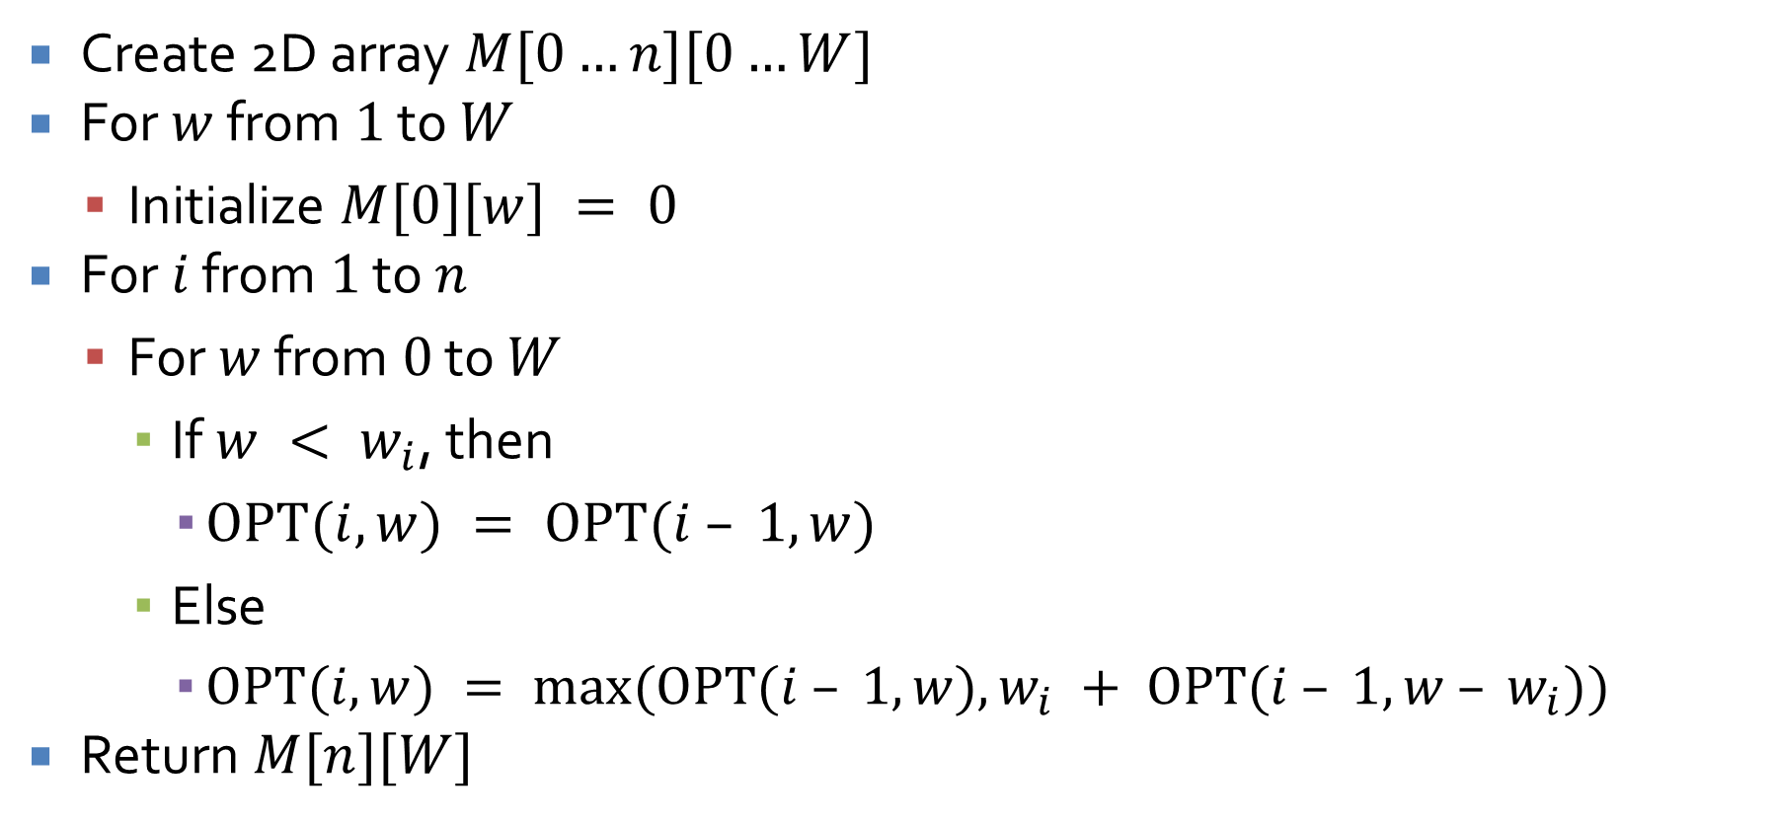
Subset-Sum(n,W)
Create 2D array $M[0…n][0…W]$
For $w$ from $1$ to $W$
  Initialize $M[0][w] = 0$
For $i$ from $1$ to $n$
  For $w$ from $0$ to $W$
    If $w < w_{i}$, then
      $OPT(i, w) = OPT(i – 1, w)$
    Else
      $OPT(i, w) = max⁡(OPT(i – 1, w), w_{i} + OPT(i – 1, w – w_{i}))$
Return $M[n][W]$

Slide 59
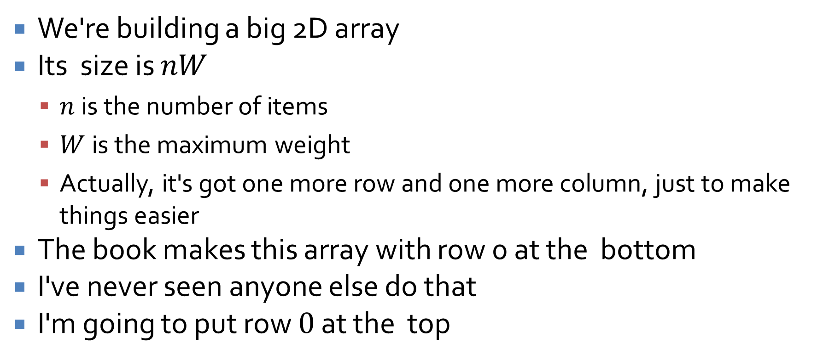
What does that look like?
We're building a big 2D array
Its size is $nW$
  $n$ is the number of items
  $W$ is the maximum weight
  Actually, it's got one more row and one more column, just to make things easier
The book makes this array with row 0 at the bottom
I've never seen anyone else do that
I'm going to put row $0$ at the top

Slide 60
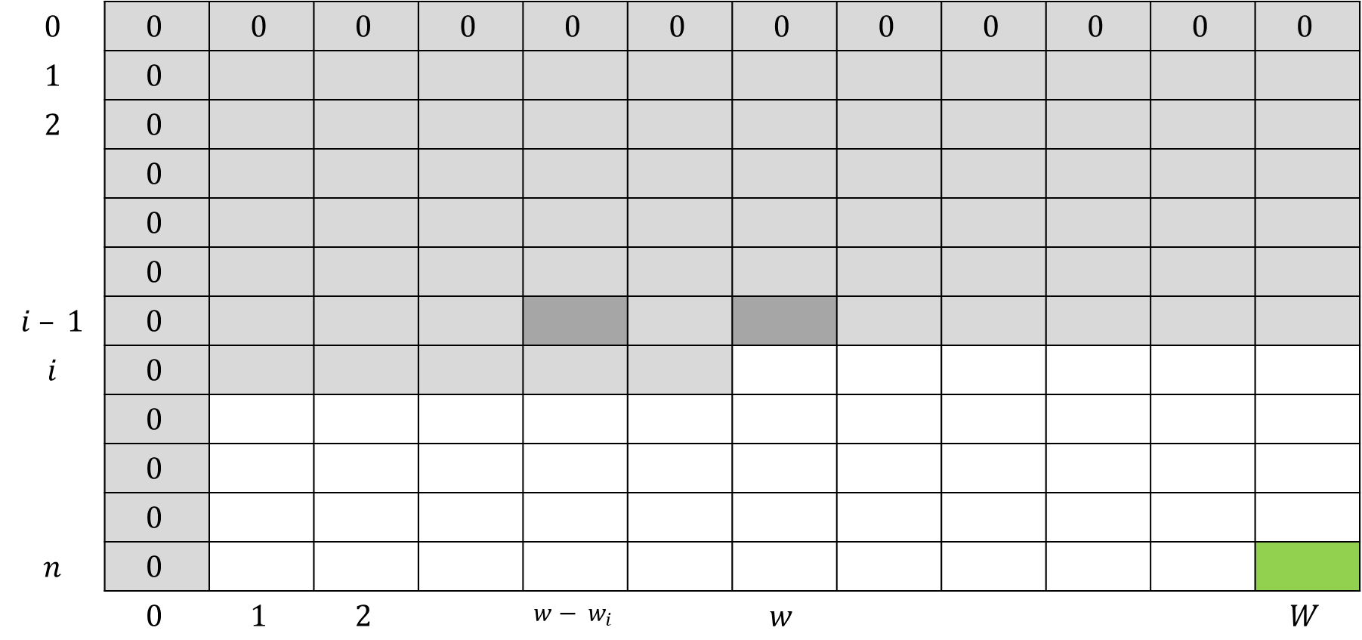

Table $M$ of OPT values
$$0$$ | $$0$$ | $$0$$ | $$0$$ | $$0$$ | $$0$$ | $$0$$ | $$0$$ | $$0$$ | $$0$$ | $$0$$ | $$0$$ | $$0$$
$$1$$ | $$0$$
$$2$$ | $$0$$
 | $$0$$
 | $$0$$
 | $$0$$
$$i – 1$$ | $$0$$
$$i$$ | $$0$$
 | $$0$$
 | $$0$$
 | $$0$$
$$n$$ | $$0$$
 | $$0$$ | $$1$$ | $$2$$ |  | $$w− w_{i}$$ |  | $$w$$ |  |  |  |  | $$W$$

Slide 61
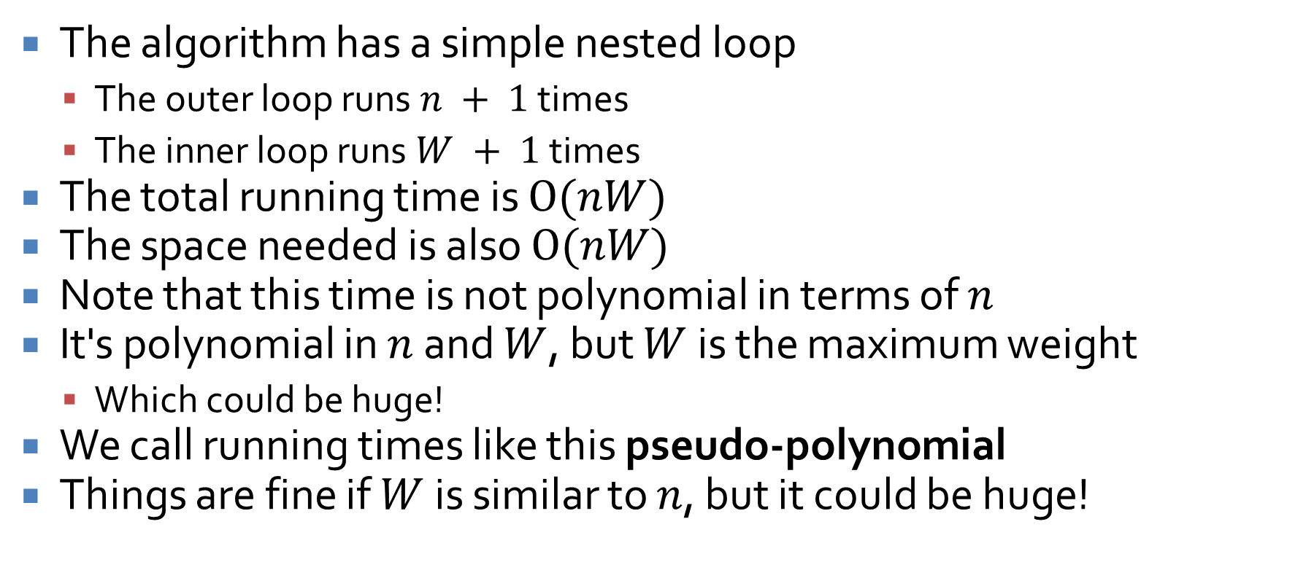
Running time
The algorithm has a simple nested loop
  The outer loop runs $n + 1$ times
  The inner loop runs $W + 1$ times
The total running time is $O(nW)$
The space needed is also $O(nW)$
Note that this time is not polynomial in terms of $n$
It's polynomial in $n$ and $W$, but $W$ is the maximum weight
  Which could be huge!
We call running times like this pseudo-polynomial
Things are fine if $W$ is similar to $n$, but it could be huge!

Slide 62

Subset sum example
Weights: $1, 4, 8, 3, 6$
Maximum: $15$
Create the table to find all of the optimal values that include items $1, 2,…, i$for every possible weight $w$ up to $15$

Slide 63
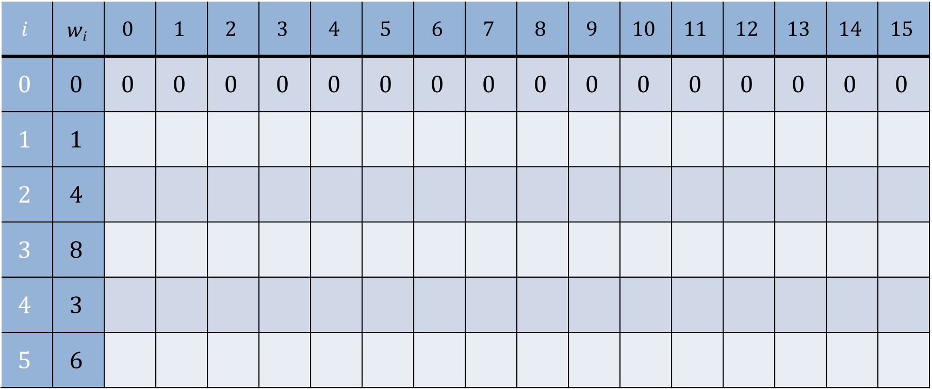
Table to fill in
$$i$$ | $$wi$$ | $$0$$ | $$1$$ | $$2$$ | $$3$$ | $$4$$ | $$5$$ | $$6$$ | $$7$$ | $$8$$ | $$9$$ | $$10$$ | $$11$$ | $$12$$ | $$13$$ | $$14$$ | $$15$$
$$0$$ | $$0$$ | $$0$$ | $$0$$ | $$0$$ | $$0$$ | $$0$$ | $$0$$ | $$0$$ | $$0$$ | $$0$$ | $$0$$ | $$0$$ | $$0$$ | $$0$$ | $$0$$ | $$0$$ | $$0$$
$$1$$ | $$1$$
$$2$$ | $$4$$
$$3$$ | $$8$$
$$4$$ | $$3$$
$$5$$ | $$6$$

Slide 64
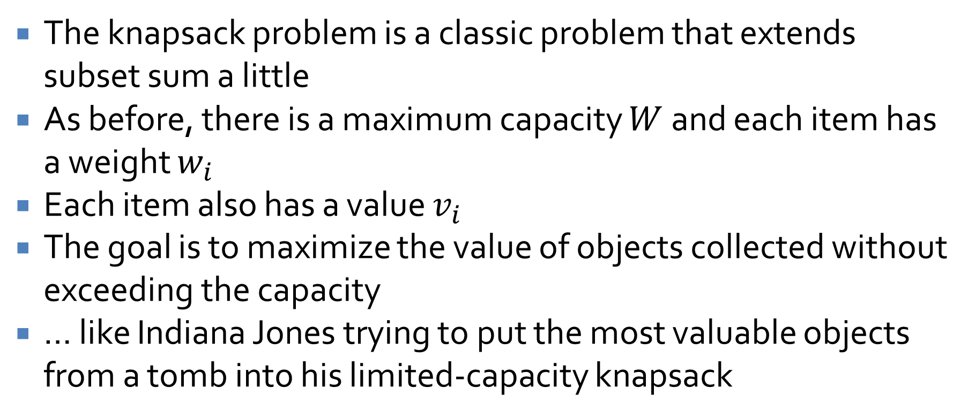
Knapsack
The knapsack problem is a classic problem that extends subset sum a little
As before, there is a maximum capacity $W$ and each item has a weight $w_{i}$
Each item also has a value $v_{i}$
The goal is to maximize the value of objects collected without exceeding the capacity
… like Indiana Jones trying to put the most valuable objects from a tomb into his limited-capacity knapsack

Slide 65
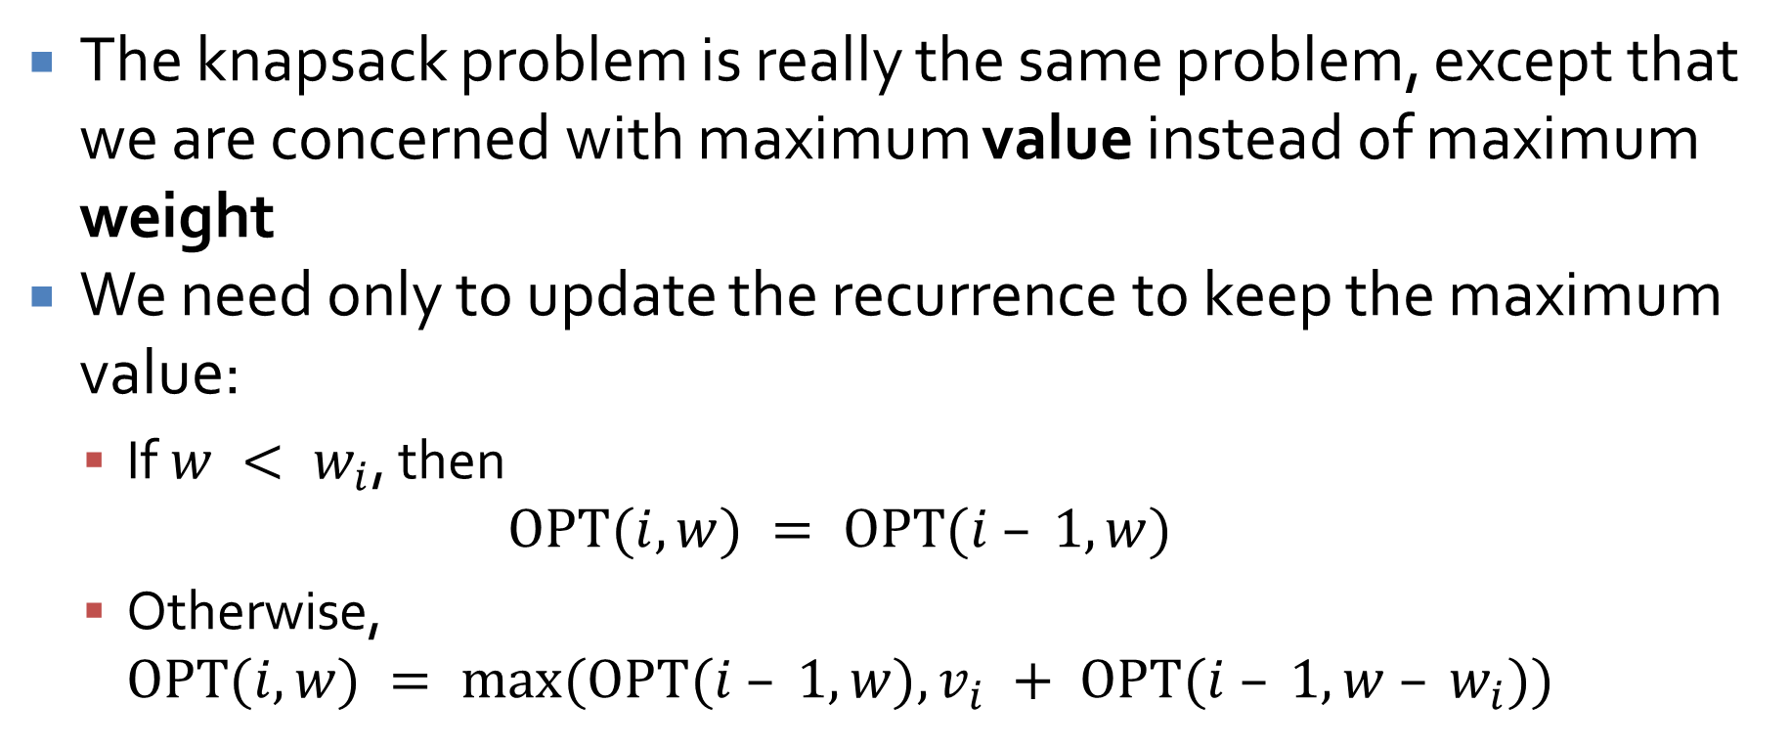
An easy extension
The knapsack problem is really the same problem, except that we are concerned with maximum value instead of maximum weight
We need only to update the recurrence to keep the maximum value:
  If $w < w_{i}$, then
  $$OPT(i, w) = OPT(i – 1, w)$$
  Otherwise,
  $$OPT(i, w) = max⁡(OPT(i – 1, w), v_{i} + OPT(i – 1, w – w_{i}))$$

Slide 66
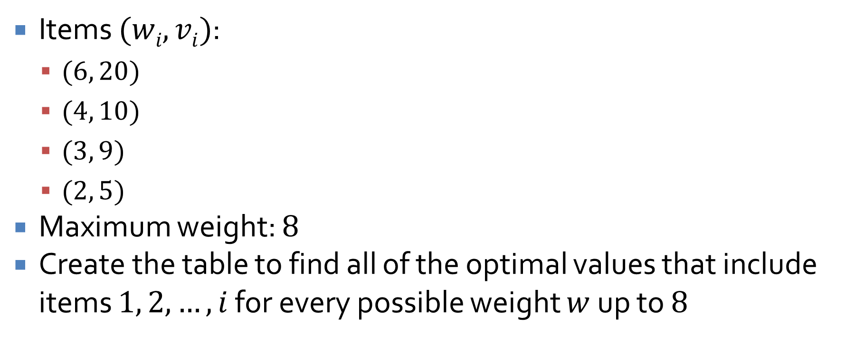
Knapsack example
Items $(wi, vi)$:
  $(6, 20)$
  $(4, 10)$
  $(3, 9)$
  $(2, 5)$
Maximum weight: $8$
Create the table to find all of the optimal values that include items $1, 2,…, i$ for every possible weight $w$ up to $8$

Slide 67
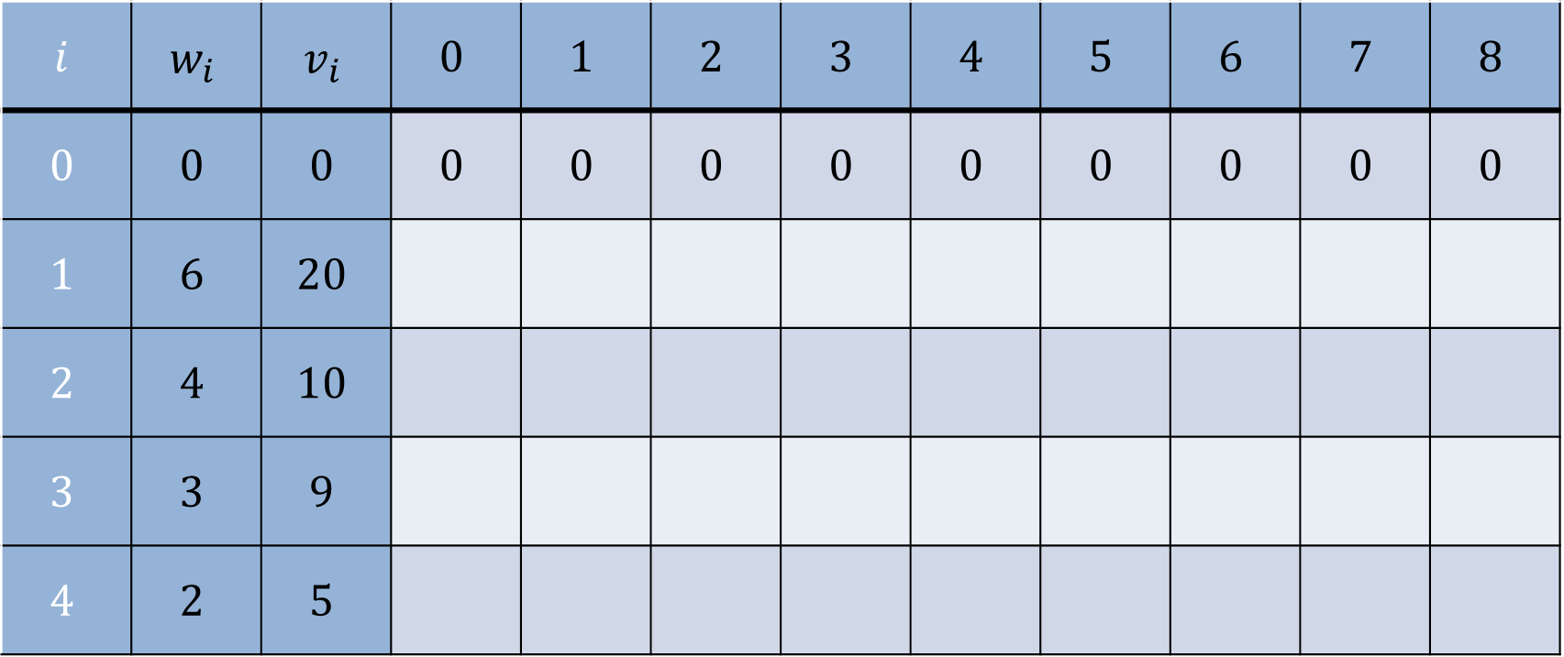
Fill in the table
$$i$$ | $$w_{i}$$ | $$v_{i}$$ | $$0$$ | $$1$$ | $$2$$ | $$3$$ | $$4$$ | $$5$$ | $$6$$ | $$7$$ | $$8$$
$$0$$ | $$0$$ | $$0$$ | $$0$$ | $$0$$ | $$0$$ | $$0$$ | $$0$$ | $$0$$ | $$0$$ | $$0$$ | $$0$$
$$1$$ | $$6$$ | $$20$$
$$2$$ | $$4$$ | $$10$$
$$3$$ | $$3$$ | $$9$$
$$4$$ | $$2$$ | $$5$$

Slide 68
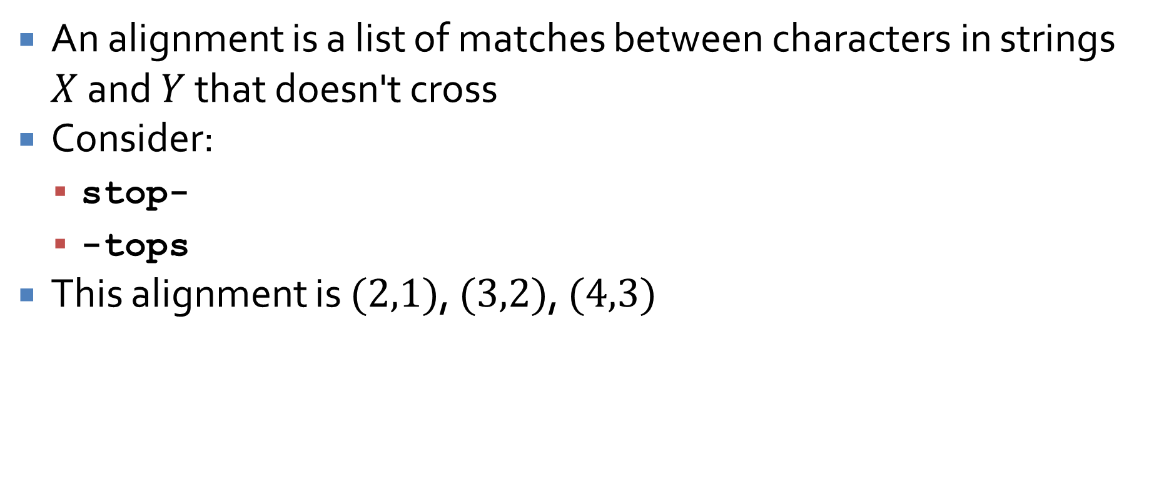
Alignment
An alignment is a list of matches between characters in strings $X$ and $Y$ that doesn't cross
Consider:
  stop-
  -tops
This alignment is $(2,1)$, $(3,2)$, $(4,3)$

Slide 69
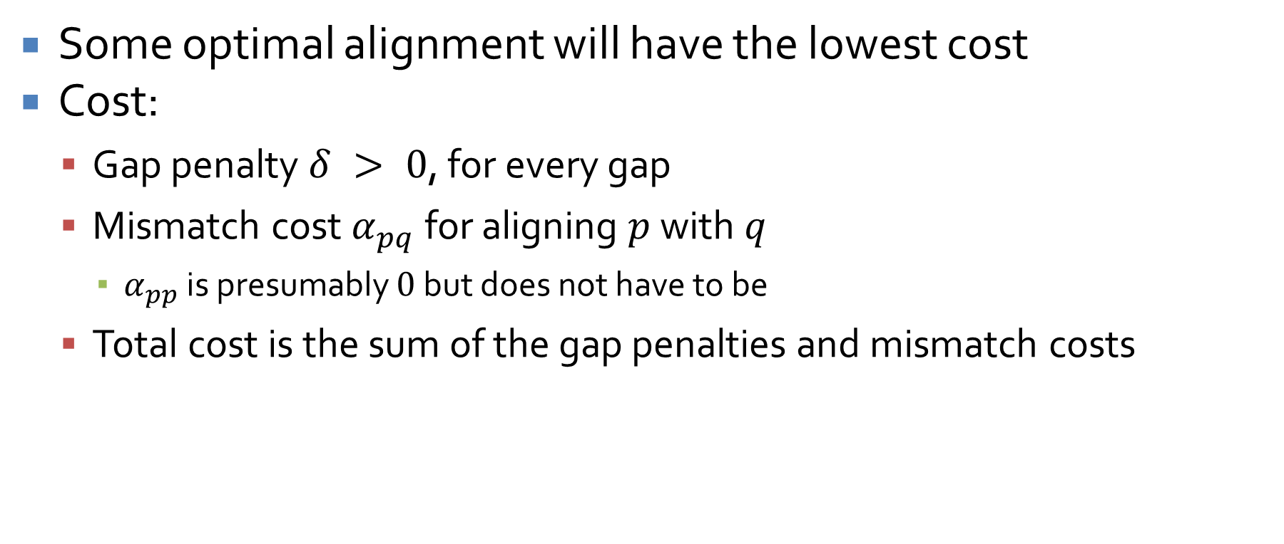
Alignment cost
Some optimal alignment will have the lowest cost
Cost:
  Gap penalty $δ > 0$, for every gap
  Mismatch cost $α_{pq}$ for aligning $p$ with $q$
    $α_{pp}$ is presumably $0$ but does not have to be
  Total cost is the sum of the gap penalties and mismatch costs

Slide 70
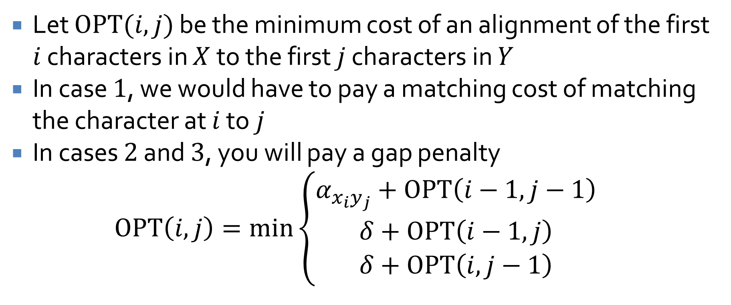
Formulating the recurrence
Let $OPT(i, j)$ be the minimum cost of an alignment of the first $i$ characters in $X$ to the first $j$ characters in $Y$
In case $1$, we would have to pay a matching cost of matching the character at $i$ to $j$
In cases $2$ and $3$, you will pay a gap penalty
$$OPT\left(i,j\right)=\min\left\{\begin{aligned}α_{x_{i}y_{j}}+OPT\left(i−1,j−1\right) \\ δ+OPT\left(i−1,j\right) \\ δ+OPT\left(i,j−1\right)\end{aligned}\right.$$

Slide 71
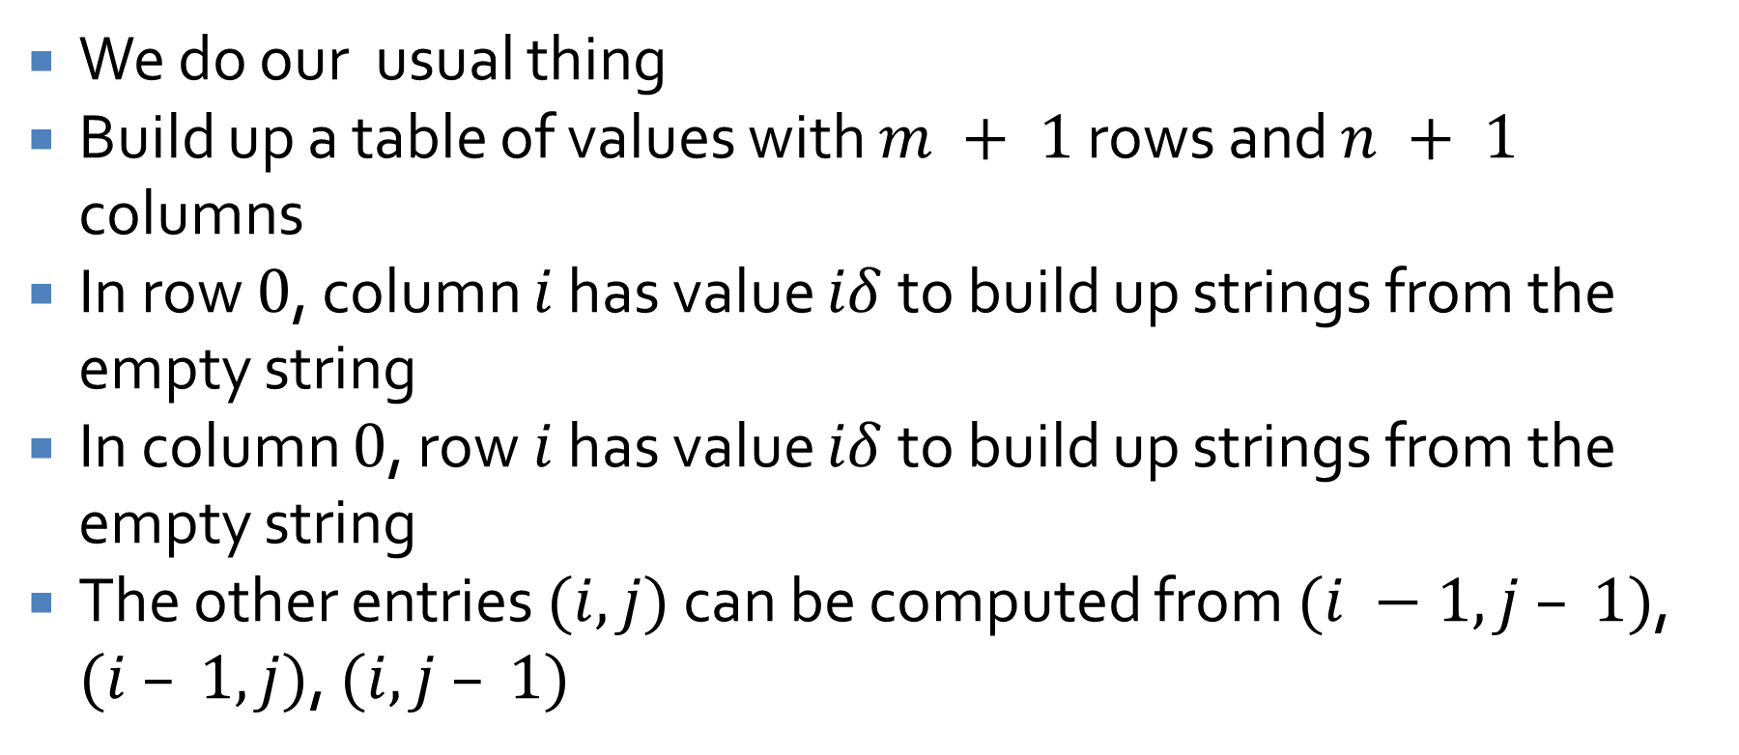
Now what?
We do our usual thing
Build up a table of values with $m + 1$ rows and $n + 1$ columns
In row $0$, column $i$ has value $iδ$ to build up strings from the empty string
In column $0$, row $i$ has value $iδ$ to build up strings from the empty string
The other entries $(i,j)$ can be computed from $(i −1, j – 1)$, $(i – 1, j)$, $(i, j – 1)$

Slide 72
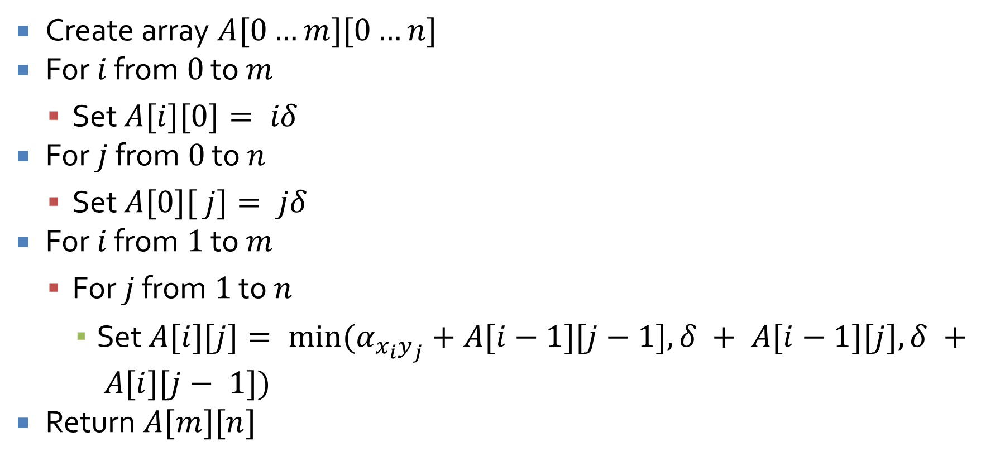

Alignment($X,Y$)
Create array $A[0…m][0…n]$
For $i$ from $0$ to $m$
  Set $A[i][0]= iδ$
For $j$ from $0$ to $n$
  Set $A[0][ j]= jδ$
For $i$ from $1$ to $m$
  For $j$ from $1$ to $n$
    Set $A[i][j]= min⁡(α_{x_{i}y_{j}}+A[i−1][j−1], δ + A[i−1][j], δ + A[i][j− 1])$
Return $A[m][n]$

Slide 73

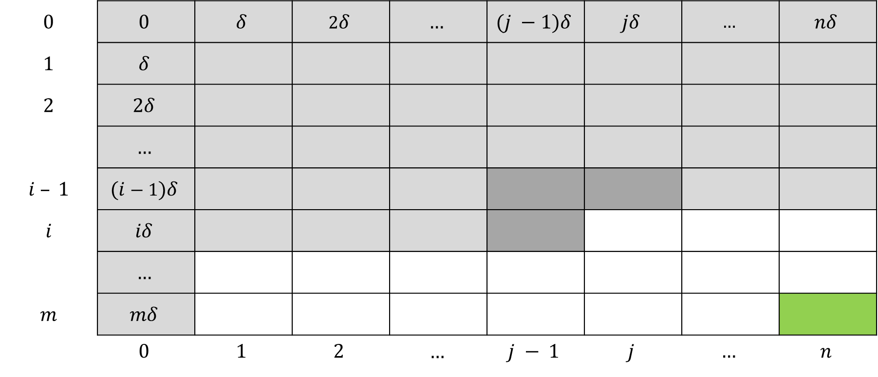
Table $A$ of OPT values
$$0$$ | $$0$$ | $$δ$$ | $$2δ$$ | $$…$$ | $$(j −1)δ$$ | $$jδ$$ | $$…$$ | $$nδ$$
$$1$$ | $$δ$$
$$2$$ | $$2δ$$
 | $$…$$
$$i – 1$$ | $$(i−1)δ$$
$$i$$ | $$iδ$$
 | $$…$$
$$m$$ | $$mδ$$
 | $$0$$ | $$1$$ | $$2$$ | $$…$$ | $$j − 1$$ | $$j$$ | $$…$$ | $$n$$

Slide 74
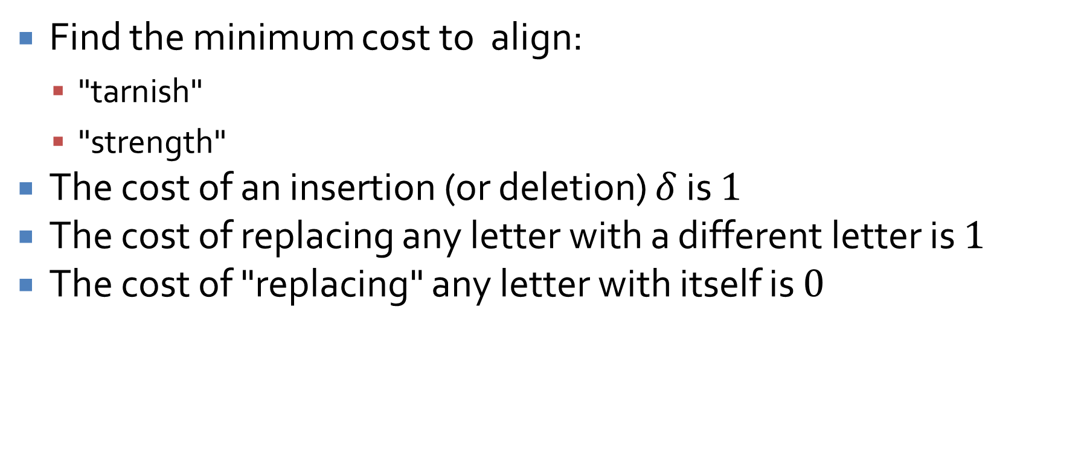
Sequence alignment example
Find the minimum cost to align:
  "tarnish"
  "strength"
The cost of an insertion (or deletion) $δ$ is $1$
The cost of replacing any letter with a different letter is $1$
The cost of "replacing" any letter with itself is $0$

Slide 75
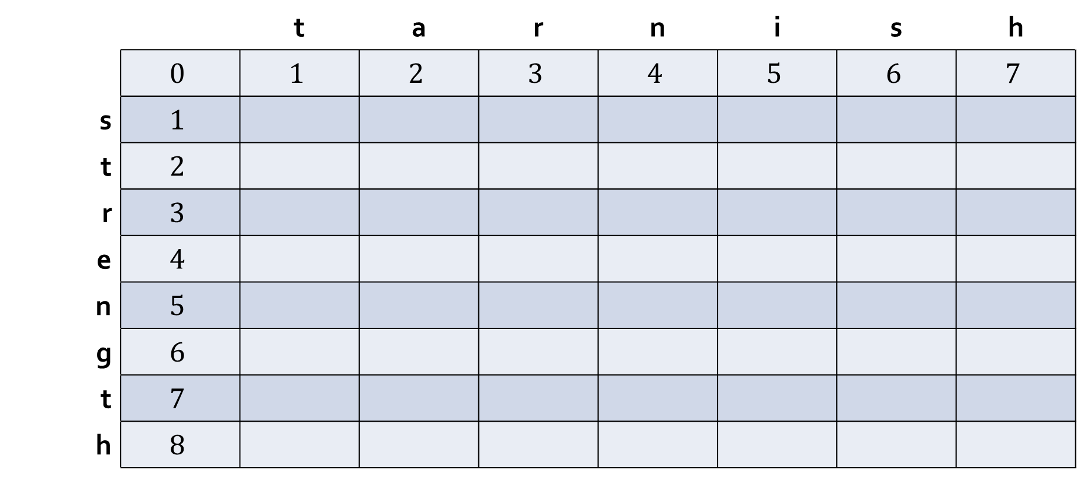
Fill in the table
 |  | t | a | r | n | i | s | h
 | $$0$$ | $$1$$ | $$2$$ | $$3$$ | $$4$$ | $$5$$ | $$6$$ | $$7$$
s | $$1$$
t | $$2$$
r | $$3$$
e | $$4$$
n | $$5$$
g | $$6$$
t | $$7$$
h | $$8$$

Slide 76
Ticket Out the Door

Slide 77
Upcoming

Slide 78
Next time…
Review final third of the course
  Flow networks
  NP-completeness
  Approximation algorithms

Slide 79
Reminders
Finish Assignment 7
  Due Wednesday by midnight
Review chapters 7, 8, and 11
Final exam:
  Friday, April 24, 2026
  10:15 a.m. – 12:15 p.m.

